Slide 1


CMR ENGINEERING COLLEGE
(UGC AUTONOMOUS)
(Accredited by NBA,Approved by AICTE NEW DELHI, Affiliated to JNTU-Hyderabad)
Kandlakoya, Medchal Road, Hyderabad-501 401.
Department of Computer Science & Engineering
Mini Project
On
Fraud Detection and Analysis for Insurance
Claim using Machine Learning .
Internal Guide:-
Dr. C.N. Ravi, Professor,
Dept. of CSE.
Presented By:
Shivam Kumar :208R1A05N4
Kyasa Vyshnavi :208R1A05L1
P. Madhu Prasad :218R5A0519
G. Nithin Krishna Goud :208R1A05J8
A.Y: 2023-2024

Slide 2
TABLE OF CONTENTS
Abstract
Introduction
Literature Survey
Existing System
Proposed System
Software Requirements
Hardware Requirements
Data Flow diagram

Slide 3
UML Diagrams
System Architecture
Flow Chart Diagram(User)
Flow Chart Diagram(Admin)
Testing
Output
Conclusion
Future Enhancements
References

Slide 4
ABSTRACT
Insurance Company working as commercial enterprise from last few years have been experiencing fraud cases for all type of claims.
Amount claimed by fraudulent is significantly huge that may causes serious problems, hence along with government, different organization also working to detect and reduce such activities.
Such frauds occurred in all areas of insurance claim with high severity such as insurance claimed towards auto sector is fraud that widely claimed and prominent type, which can be done by fake accident claim.
So, we aim to develop a project that work on insurance claim data set to detect fraud and fake claims amount

Slide 5
INTRODUCTION
Now-a-days Insurance Fraud is basically intentional deceit that can be done by or against an insurance company or an agent with the motive of monetary gain.
It is a serious and acute growing menace as fraudulent insurance applications increase the burden on the community in the form of high premiums rates.
As a result, these concerns bring the attention of machine learning and data analytics communities to find a solution to this problem.
Similarly, our proposed work differentiates fraudulent and non-fraudulent claims with high accuracy, so that only fraud cases need to be scrutinized and legit cases get claimed without wasting time and resources.

Slide 6
LITERATURE SURVEY
“Fraud Detection in health insurance using data mining techniques”– Vipula Rawte et all, IEEE 2015.
Fraud involves intentional deception or misrepresentation intended to result in an unauthorized benefit. It is shocking because the incidence of health insurance fraud Data mining which is divided into two learning techniques supervised and unsupervised is employed. By combining the advantages techniques, detecting fraudulent claims in health insurance industry is proposed.

Slide 7
"Predicting medical provider specialties to detect anomalous insurance claims." – Bauder, Richard A. Taghi M. Khoshgoftaar, Aaron Richter, and Matthew Herland, IEEE 2016
One issue in this field is the misuse of medical insurance systems, such as Medicare. In this paper, we build a machine learning model to detect when physicians exhibit anomalous behavior in their medical insurance claims. This research provides a model that can identify physicians who are potentially misusing insurance systems for further investigation.

Slide 8
EXISTING SYSTEM
Different forms of fraud lead to various crimes, however, many cases involve intentional injury to an insured object or the purpose of obtaining assets without payment.
The process of detecting fraud in the insurance industry is not only expensive but also time-consuming.
However, the existing technology in the past was pre-programmed, which means that a consistent template was designed to detect fraudulent applications; and if a particular claim fits that figure it will only be identified as illegal, or else it will not be recognized.
To classify, combine cluster data, and segment, using data mining that can find rules in data and be able to highlight specific patterns, including those related to fraud.

Slide 9
DRAWBACKS
The system is not implemented Convex-NMF based Supervised Spammer Detection with Social Interaction (CNMFSD).
The system is not implemented any ml classifier for test and train the datasets.

Slide 10
PROPOSED SYSTEM
Initially, data that is received in batches from the client is checked to see if it is in the format that was agreed upon; if not, it is deleted and sent to the archived folder. The next step is transformation, which modifies the data's format to make it appropriate for entry into the database.
Once the training is completed, now the model is fit for prediction. Now, data taken from the client for prediction is again checked, and appropriate changes are performed to make it suitable for insertion in the database.
After setting up the Heroku cloud platform, required files needed for pushing the model are added to the model, and the application is pushed on the cloud.

Slide 11
PROS
Binary Classification task takes place which gives answer between YES or NO. This report deals with classification algorithm to detect fraudulent transaction.
A predictive model is created that predicts if an insurance claim is fraudulent or not.

Slide 12
SOFTWARE REQUIREMENTS
Operating system : Windows 11 pro
Coding Language : Python
Front-End : HTML, CSS, JavaScript
Back-End : Django ORM- Frame Work
Data Base : MySQL (WAMP Server).

Slide 13
HARDWARE REQUIREMENTS
Processor : Intel i5
RAM : 8 GB
Hard Disk : 1 TB
Key Board : Standard Windows Keyboard

Slide 14
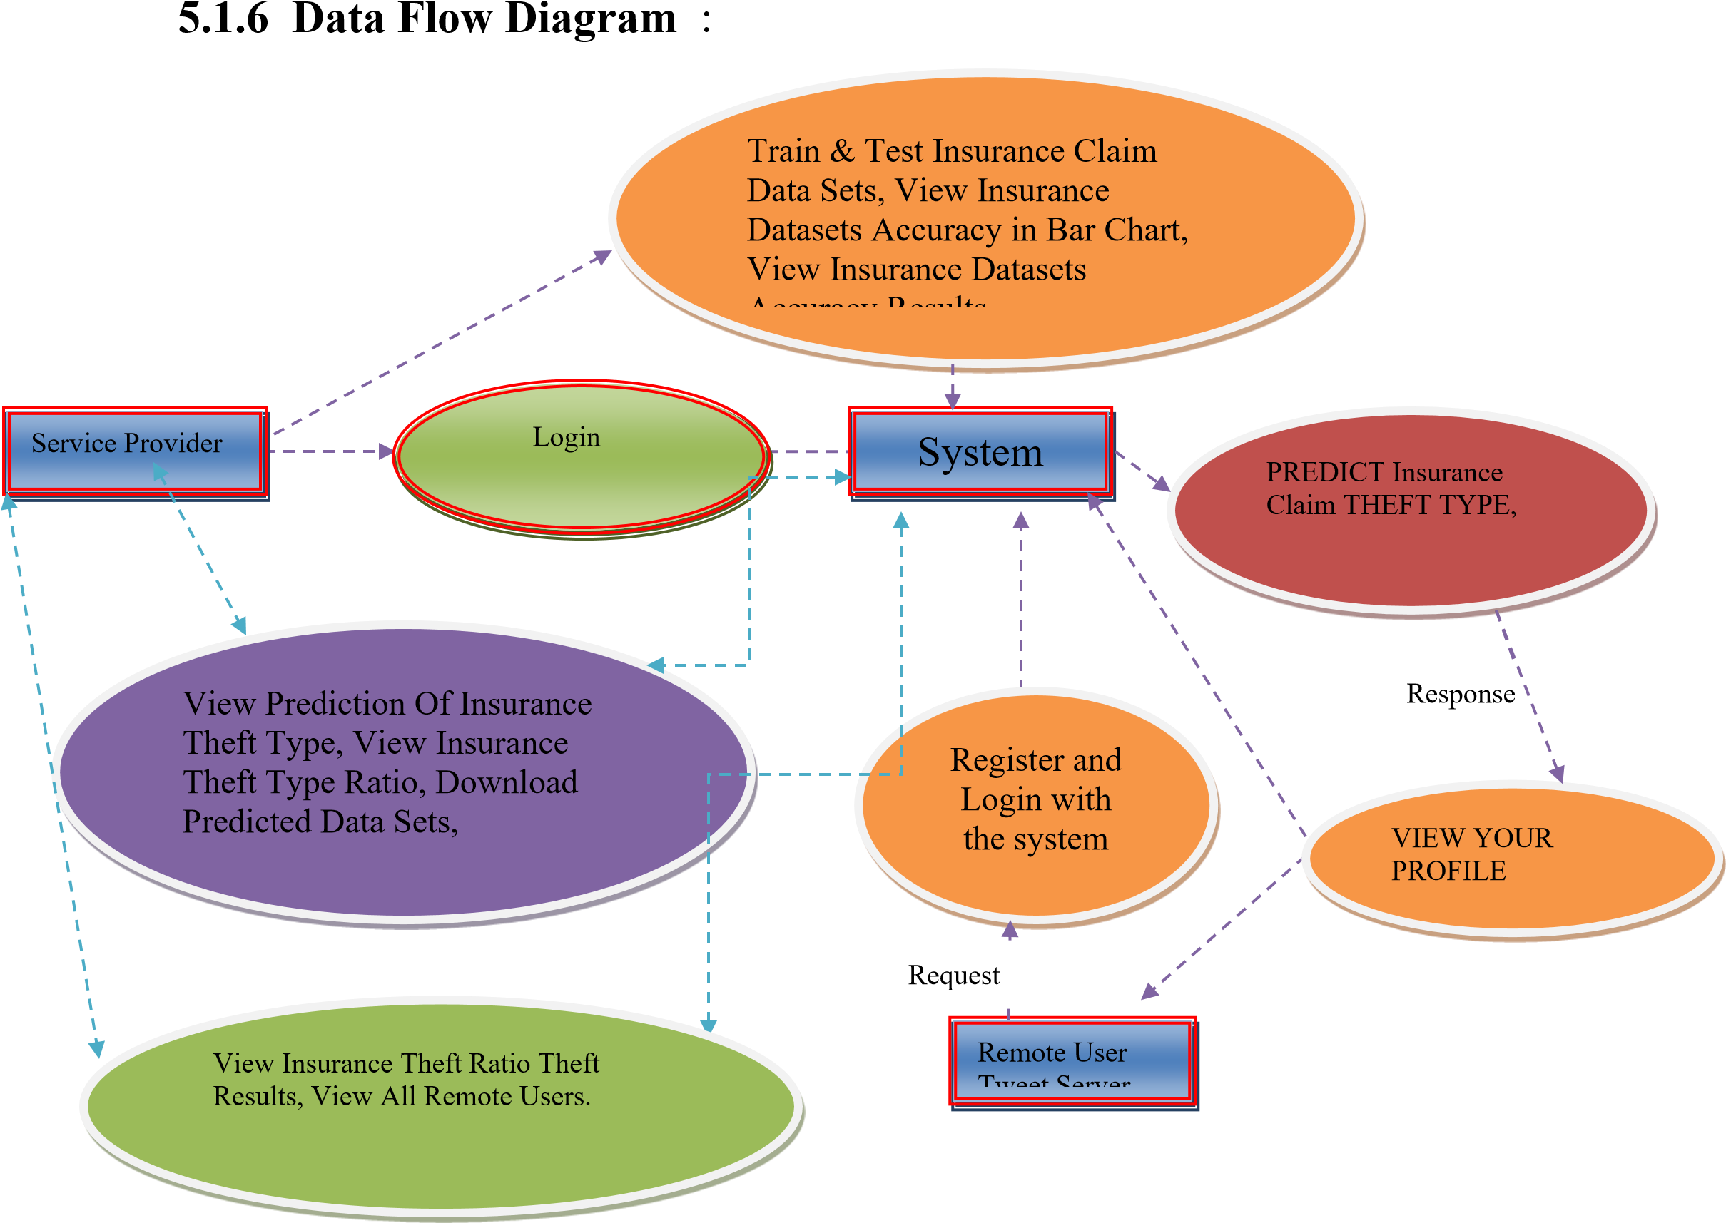
DATA FLOW DIAGRAM
The data flow diagram that determines the information regarding the definition and use of data in program

Slide 15
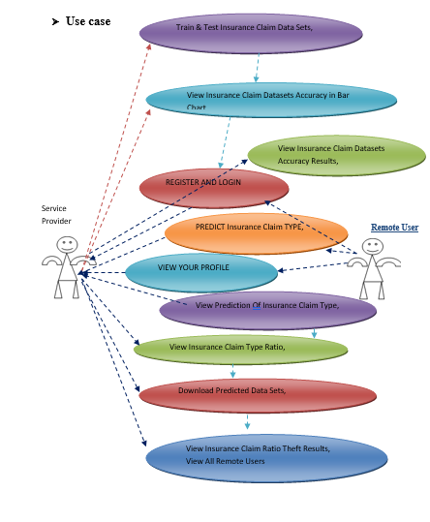
USE CASE DIAGRAM
A use case diagram in the Unified Modeling Language (UML) is a type of behavioral diagram defined by and created from a Use-case analysis.

Slide 16
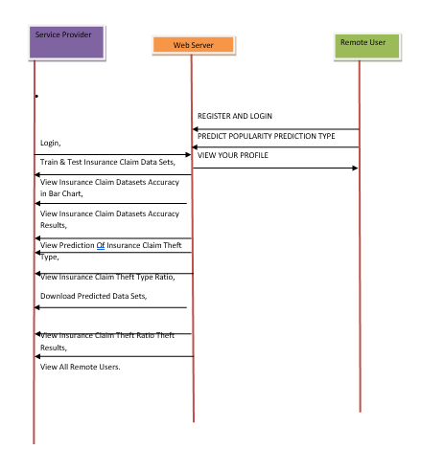
SEQUENCE DIAGRAM
A sequence diagram in Unified Modeling Language (UML) is a kind of interaction diagram that shows how processes operate with one another and in what order.

Slide 17
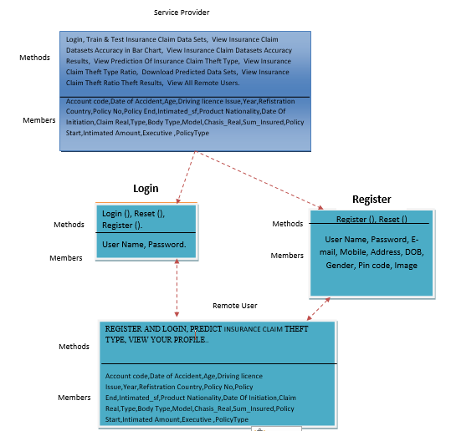
CLASS DIAGRAM
A class diagram is a type of static structure diagram that describes the structure of a system by showing the system's classes, their the attributes, operation and the relationships among the classes. It explains which class contains information

Slide 18
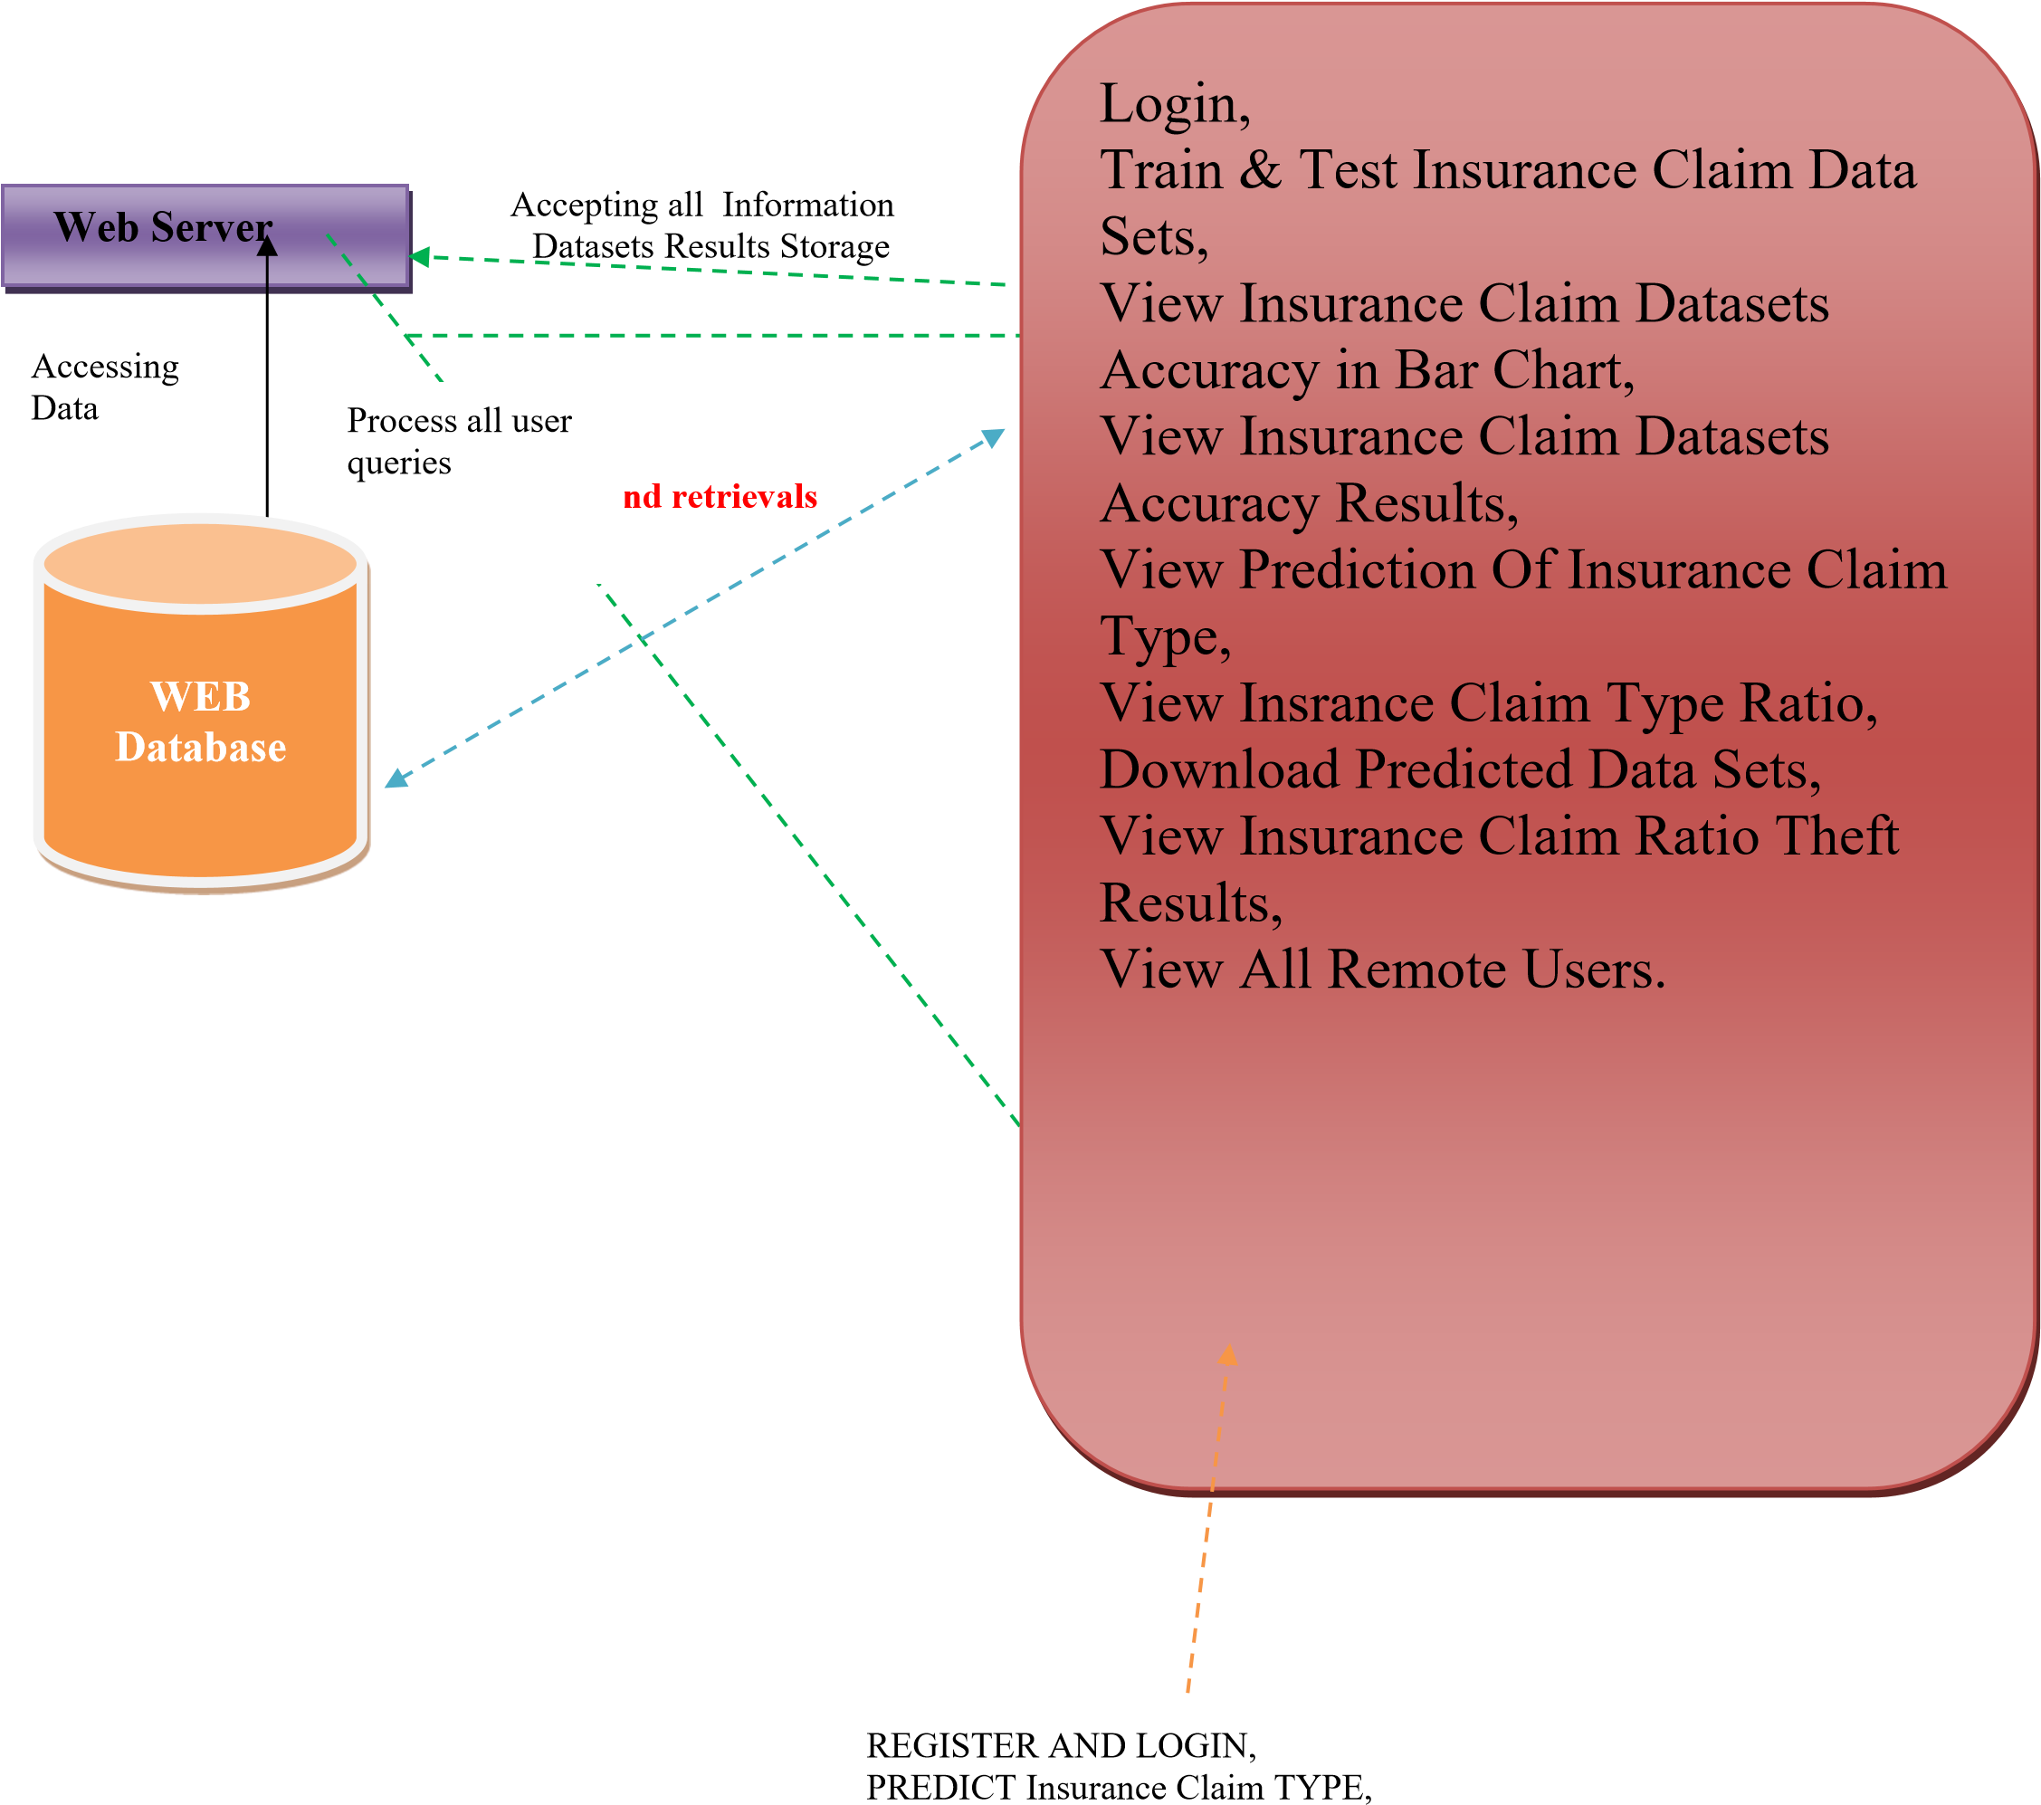
ARCHITECTURE DIAGRAM
An architecture diagram is a visual representation of all the elements that make up part, or all, of a system

Slide 19
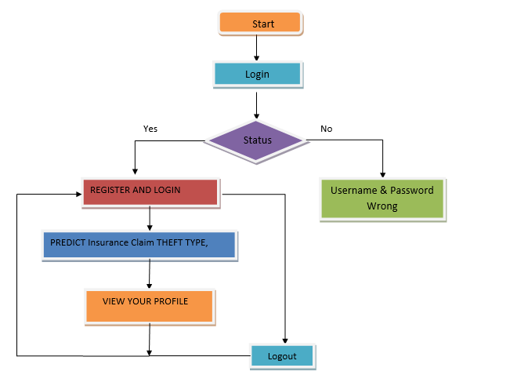
FLOW CHART DIAGRAM (USER)
User can login and register .
If the login is successful then move to the next step or else it will display the wrong message.

Slide 20
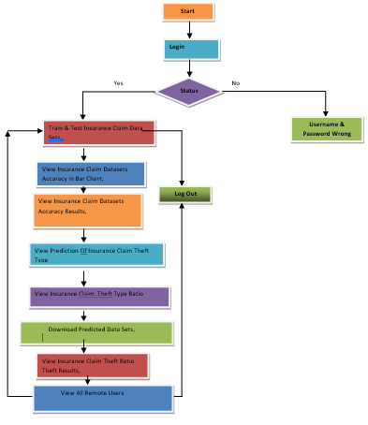
FLOW CHART DIAGRAM(ADMIN)
Admin is used to store the user information.
It contain all the information about the datasets.

Slide 21
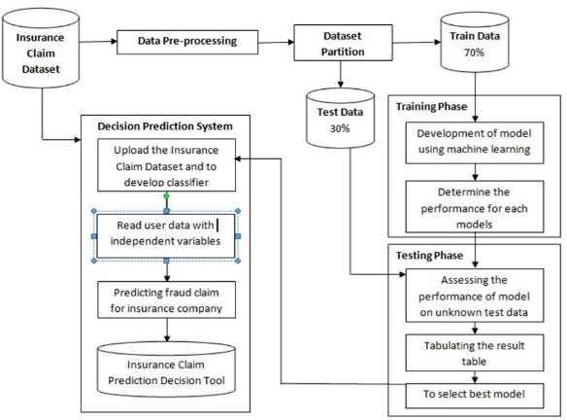
SYSTEM ARCHITECTURE
Machine learning model is built with different algorithms that is trained by information and data set provided which predict new classification as fraud or not.
These algorithms implemented for building model that is trained using historical data and that predict the output.

Slide 22
TESTING
The purpose of testing is to discover errors.
Types of Testing
Unit testing
Integration testing
Functional test
White Box Testing
Black Box Testing

Slide 23
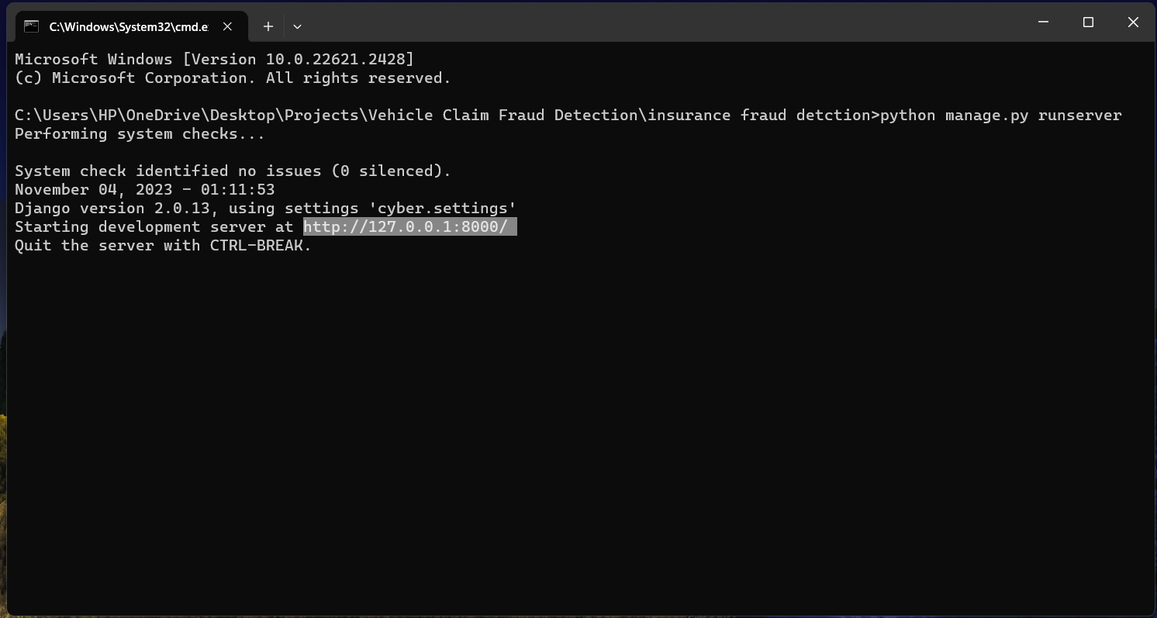

OUTPUT

Slide 24
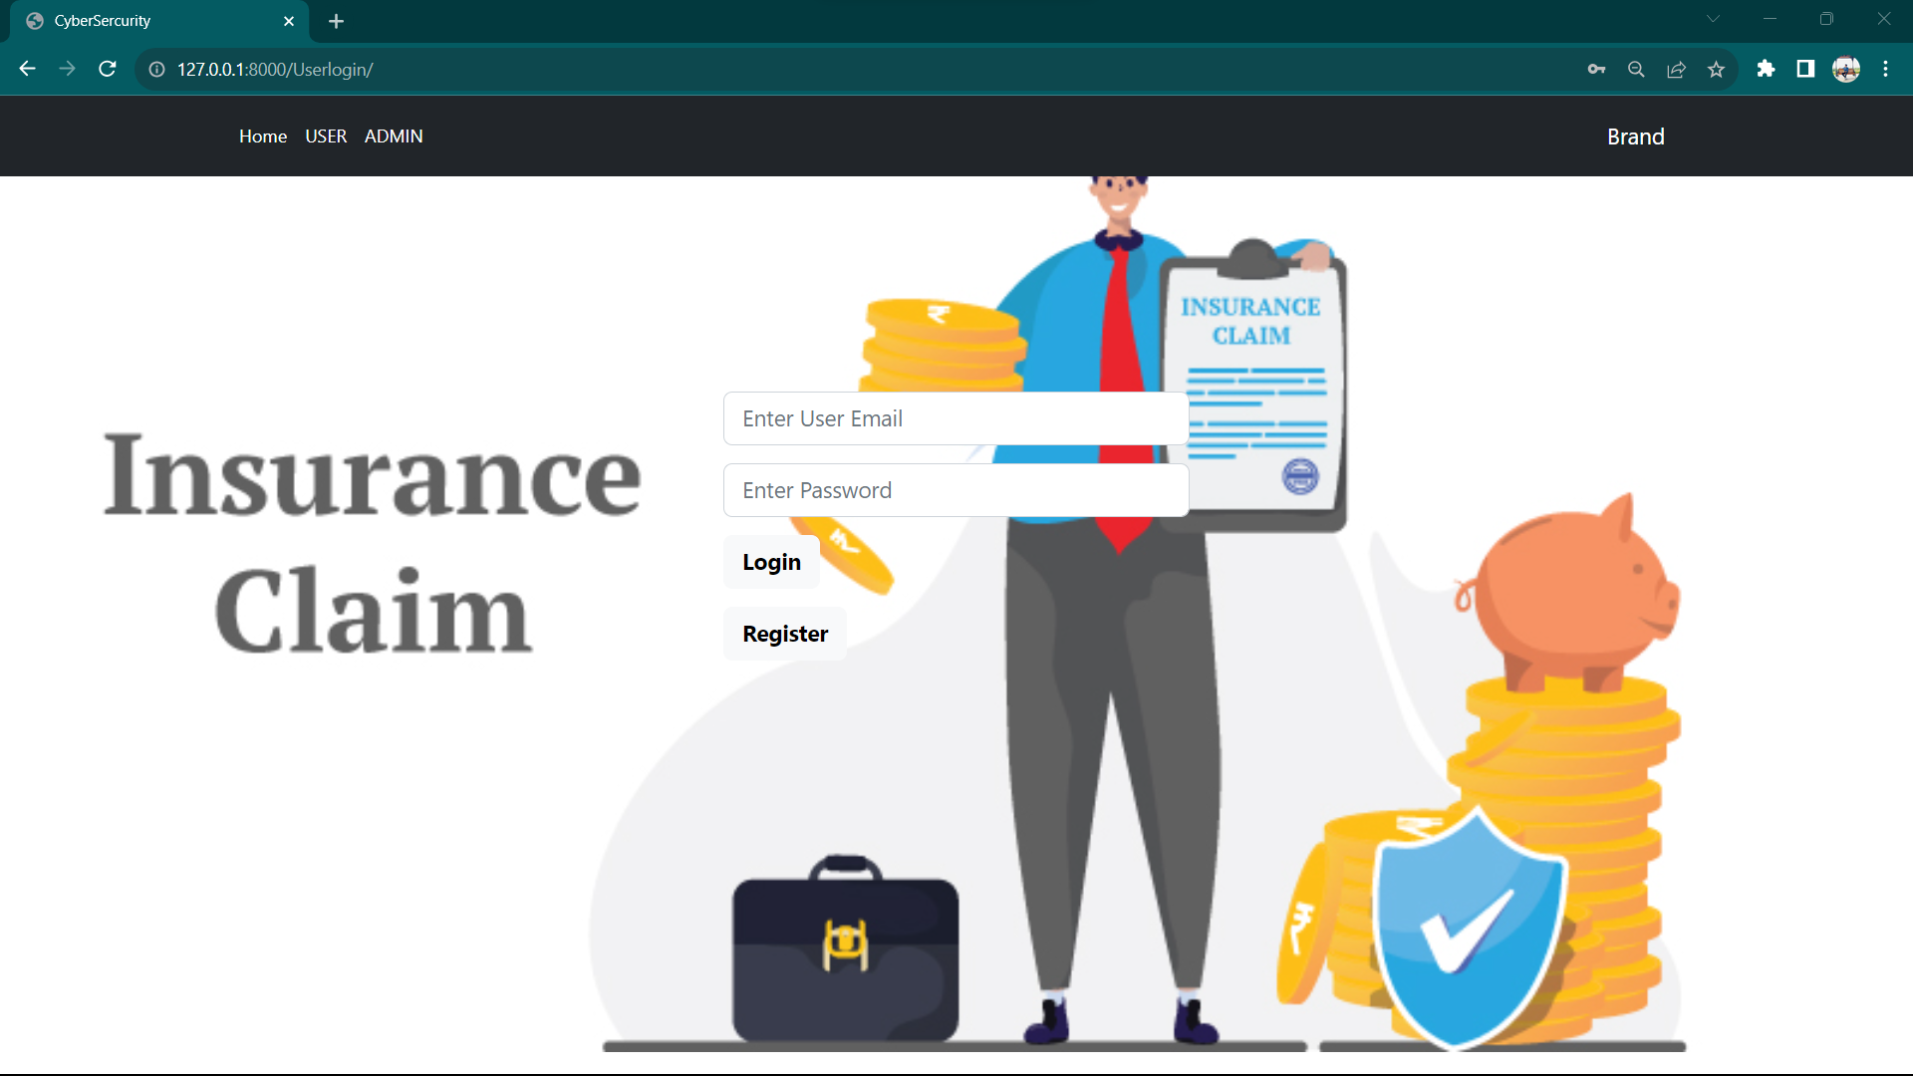


Slide 25
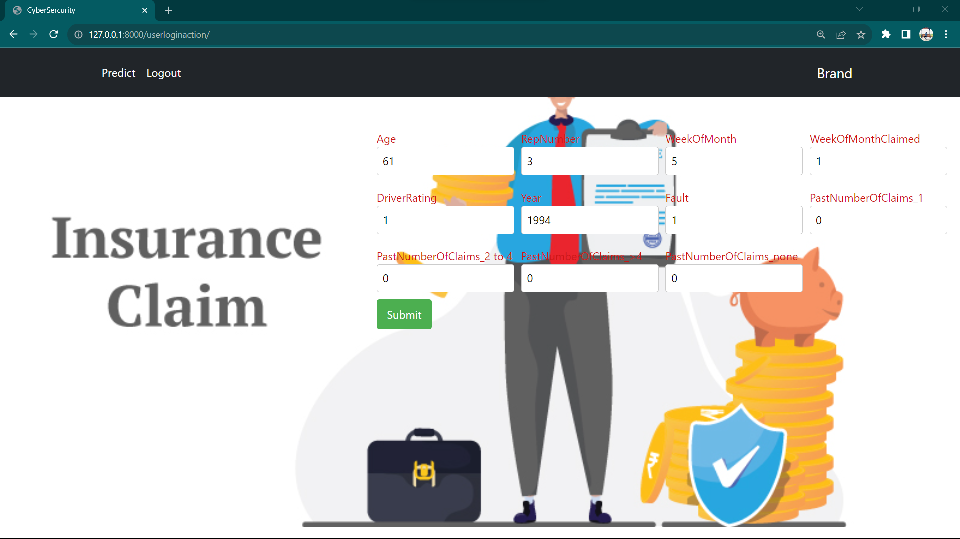
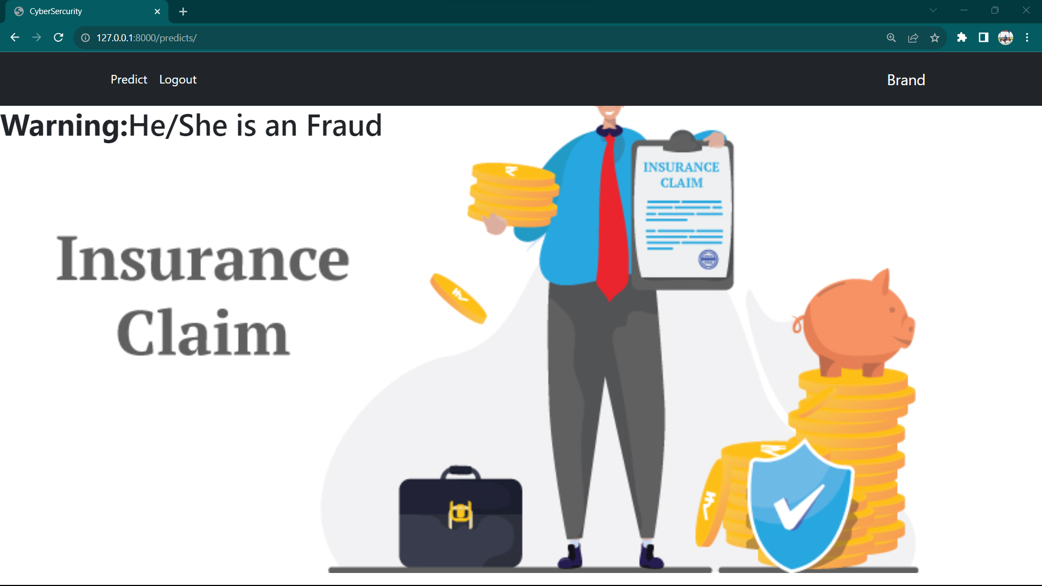

Slide 26
CONCLUSION
As the different countries around the world evolve into a more economical-based one, stimulating their economy is the goal.
The proposed solution can be used in insurance companies to find out if a certain insurance claim made is a fraud or not.
The model was designed after testing multiple algorithms to come up with the best model that will detect if a claim is fraudulent or not.

Slide 27
FUTURE ENHANCEMENTS
In order to compare the effectiveness of machine learning future research should focus on attempting to use an advanced or recently obtained dataset.
Additionally, it is advised to utilize a different dataset in order to get the appropriate outcome and using the data mining algorithms.

Slide 28
REFERNCES
Abhinav Srivastava, A. K. (2008). Credit Card Fraud Detection Using. IEEE TRANSACTIONS ON DEPENDABLE AND SECURE COMPUTING, 37 - 48.
Aisha Abdallah, M. A. (2016). Fraud detection system: A survey. Journal of Network and Computer Applications, 90-113.
Andrea Dal Pozzolo, G. B. (2018). Credit Card Fraud Detection: A Realistic Modeling. IEEE TRANSACTIONS ON NEURAL NETWORKS AND LEARNING SYSTEMS, vol 29, NO 8

Slide 29


